Slide 1
Chapter: Requirement Engineering

Slide 2
Requirements Engineering
Requirement: A function, constraint or other property that the system must provide to fill the needs of the system’s intended user(s)
Engineering: implies that systematic and repeatable techniques should be used
Requirement Engineering means that requirements for a product are defined, managed and tested systematically

Slide 3
Requirements Engineering
It is essential that the software engineering team understand the requirements of a problem before the team tries to solve the problem.
In some cases requirements engineering may be abbreviated, but it is never abandoned.
RE is software engineering actions that start with communication activity and continues into the modeling activity.
RE establishes a solid base for design and construction. Without it, resulting software has a high probability of not meeting customer needs.

Slide 4
Characteristics of a Good Requirement
Clear and Unambiguous
  standard structure
  has only one possible interpretation
  Not more than one requirement in one sentence
Correct
  A requirement contributes to a real need
Understandable
  A reader can easily understand the meaning of the requirement
Verifiable
  A requirement can be tested
Complete
Consistent
Traceable

Slide 5
Why is Getting Good Requirements Hard?
Stakeholders don’t know what they really want.
Stakeholders express requirements in their own terms.
Different stakeholders may have conflicting requirements.
Organisational and political factors may influence the system requirements.
The requirements change during the RE process. New stakeholders may emerge and the business environment change.

Slide 6
Requirements Engineering Tasks
Inception —Establish a basic understanding of the problem and the nature of the solution.
Elicitation —Draw out the requirements from stakeholders.
Elaboration (Highly structured)—Create an analysis model that represents information, functional, and behavioral aspects of the requirements.
Negotiation—Agree on a deliverable system that is realistic for developers and customers.
Specification—Describe the requirements formally or informally.
Validation —Review the requirement specification for errors, ambiguities, omissions, and conflicts.
Requirements management —Manage changing requirements.

Slide 7
Inception
Inception— Ask “context-free” questions that establish …
  Basic understanding of the problem
  The people who want a solution
  The nature of the solution that is desired, and
  The effectiveness of preliminary communication and collaboration between the customer and the developer

Slide 8
Elicitation
Elicitation - elicit requirements from customers, users and others.
  Find out from customers, users and others what the product objectives are
  what is to be done
  how the product fits into business needs, and
  how the product is used on a day to day basis

Slide 9
Why Requirement elicitation is difficult?
Problems of scope:
  The boundary of the system is ill-defined.
  Customers/users specify unnecessary technical detail that may confuse rather than clarify objectives.
Problem of understanding:
  Customers are not completely sure of what is needed.
  Customers have a poor understanding of the capabilities and limitations of the computing environment.
  Customers don’t have a full understanding of their problem domain.
  Customers have trouble communicating needs to the system engineer.
  Customers omit detail that is believed to be obvious.
  Customers specify requirements that conflict with other requirements.
  Customers specify requirements that are ambiguous or not able to test.
Problems of volatility:
  Requirement change over time.

Slide 10
Elaboration
Focuses on developing a refined technical model of software functions, features, and constraints using the information obtained during inception and elicitation
Create an analysis model that identifies data, function and behavioral requirements.
It is driven by the creation and refinement of user scenarios that describe how the end-user will interact with the system.
Each event parsed into extracted.
End result defines informational, functional and behavioral domain of the problem

Slide 11
Negotiation
Negotiation - agree on a deliverable system that is realistic for developers and customers
  Requirements are categorized and organized into subsets
  Relations among requirements identified
  Requirements reviewed for correctness
  Requirements prioritized based on customer needs
  Negotiation about requirements, project cost and project timeline.
  There should be no winner and no loser in effective negotiation.

Slide 12
Specification
Specification – Different things to different people.
It can be –
  Written Document
  A set of graphical models,
  A formal mathematical models
  Collection of usage scenario.
  A prototype
  Combination of above.
The Formality and format of a specification varies with the size and the complexity of the software to be built.
For large systems, written document, language descriptions, and graphical models may be the best approach.
For small systems or products, usage scenarios

Slide 13
Validation
Requirements Validation - formal technical review mechanism that looks for
  Errors in content or interpretation
  Areas where clarification may be required
  Missing information
  Inconsistencies (a major problem when large products or systems are engineered)
  Conflicting or unrealistic (unachievable) requirements.

Slide 14
Requirement Management
  Set of activities that help project team to identify, control, and track requirements and changes as project proceeds
  Requirements begin with identification. Each requirement is assigned a unique identifier. Once requirement have been identified, traceability table are developed.
  Traceability Table:
  Features traceability table - shows how requirements relate to customer observable features
  Source traceability table - identifies source of each requirement
  Dependency traceability table - indicate relations among requirements
  Subsystem traceability table - requirements categorized by subsystem
  Interface traceability table - shows requirement relations to internal and external interfaces
  It will help to track, if change in one requirement will affect different aspects of the system.

Slide 15
Initiating Requirements Engineering Process
Identify stakeholders
  Stakeholder can be “anyone who benefits in a direct or indirect way from the system which is being developed”
  Ex. Business manager, project manager, marketing people, software engineer, support engineer, end-users, internal-external customers, consultants, maintenance engineer.
  Each one of them has different view of the system.
Recognize multiple points of view
  Marketing group concern about feature and function to excite potential market. To sell easily in the market.
  Business manager concern about feature built within budget and will be ready to meet market.
  End user – Easy to learn and use.
  SE – product functioning at various infrastructure support.
  Support engineer – Maintainability of software.
Role of RE is to categorize all stakeholder information in a way that there could be no inconsistent or conflict requirement with one another

Slide 16
Work toward collaboration
  RE identify areas of commonality (i.e. Agreed requirement) and areas of conflict or inconsistency.
  It does not mean requirement defined by committee. It may happened they providing just view of their requirement.
  Business manager or senior technologist may make final decision.
Asking the first questions
  Who is behind the request for this work?
  Who will use the solution?
  What will be the economic benefit of a successful solution
  Is there another source for the solution that you need?
These questions will help – stakeholder interest in the software & measurable benefit of successful implementation.

Slide 17
Asking the question
Next set of questions – better understanding of the problem.
What business problem (s) will this solution address?
Describe business environment in which the solution will be used?
will performance or productivity issues affect the solution is approached?
Final set of questions – Effectiveness of communication
Are my questions relevant to the problem?
Am I asking too many questions?
Can anyone else provide additional information?
should I be asking you anything else?

Slide 18
Eliciting Requirement
Approach for eliciting requirement:
Collaborative Requirement Gathering
Quality Function Deployment
User Scenarios
Elicitation Work Products

Slide 19
Collaborative Requirement Gathering
Meetings are attended by all interested stakeholders.
Rules established for preparation and participation.
Agenda should be formal enough to cover all important points, but informal enough to encourage the free flow of ideas.
A facilitator controls the meeting.
A definition mechanism (blackboard, flip charts, etc.) is used.
During the meeting:
  The problem is identified.
  Elements of the solution are proposed.
  Different approaches are negotiated.
  A preliminary set of solution requirements are obtained.
  The atmosphere is collaborative and non-threatening.
Flow of event – Outline the sequence of events occurs
  Requirement gathering meeting ( initial meeting)
  During meeting
  Follow the meeting.

Slide 20
Collaborative requirement gathering (contd.)
In initial meeting, distribute “Product request” (defined by stakeholder) to all attendee.
Based on product request, each attendee is asked to make
  List of objects (Internal or external system objects)
  List of services( Processes or functions)
  List of constraints ( cost, size, business rules) and performance criteria( speed, accuracy) are developed.
Collect lists from everyone and combined.
Combined list eliminates redundant entries, add new ideas , but does not delete anything.
Objective is to develop a consensus list in each topic area (objects, services, constraints and performance).
Based on lists, team is divided into smaller sub-teams : each works to develop mini-specification for one or more entries on each of the lists.

Slide 21
Collaborative requirement gathering (Contd.)
Each sub-team the presents its mini-specification to all attendees for discussion. Addition, deletion and further elaboration are made.
Now each team makes a list of validation criteria for the product and present to team.
Finally, one or more participants is assigned the task of writing a complete draft specification.

Slide 22
Quality Function Deployment
It is a technique that translate the needs of the customer into technical requirement for software.
Concentrates on maximizing customer satisfaction.
QFD emphasizes – what is valuable to the customer and then deploys these values throughout the engineering process.
Three types of requirement:
Normal Requirements – reflect objectives and goals stated for product. If requirement are present in final products, customer is satisfied.
Expected Requirements – customer does not explicitly state them. Customer assumes it is implicitly available with the system.
Exciting Requirements- Features that go beyond the customer’s expectation.
During meeting with customer –
Function deployment determines the “value” of each function required of the system.
Information deployment identifies data objects and events and also tied with functions.
Task deployment examines the behavior of the system.
Value analysis determines the priority of requirements during these 3 deployments.

Slide 23
User Scenario
It is difficult to move into more software engineering activities until s/w team understands how these functions and features will be used by diff. end-users.
Developers and users create a set of usage threads for the system to be constructed
A use-case scenario is a story about how someone or something external to the software (known as an actor) interacts with the system.
Describe how the system will be used
Each scenario is described from the point-of-view of an “actor”—a person or device that interacts with the software in some way

Slide 24
Elicitation Work Products
Elicitation work product will vary depending upon the size of the system or product to be built.
Statement of need and feasibility.
Statement of scope.
List of participants in requirements elicitation.
Description of the system’s technical environment.
List of requirements and associated domain constraints.
List of usage scenarios.
Any prototypes developed to refine requirements.

Slide 25
Software Prototype
Prototype constructed for customer and developer assessment.
In some circumstances construction of prototype is require in beginning of analysis. (To derive requirement effectively)
Selecting Prototype Approach
Close ended (Throwaway Approach)
Open ended (Evolutionary Approach)
Close Ended – It serves as a rough demonstration of requirement. It is then discarded, and the software engineered using a different paradigm.
Open Ended - uses the prototype as the first part of an analysis activity that will be continued into design and construction. The prototype of the software is the first evolution of the finished system.

Slide 26
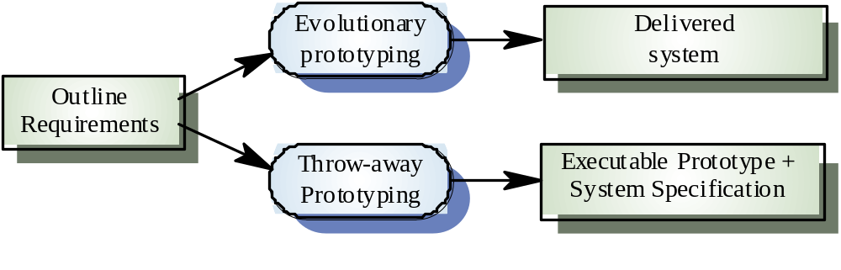
Approaches to prototyping

Slide 27
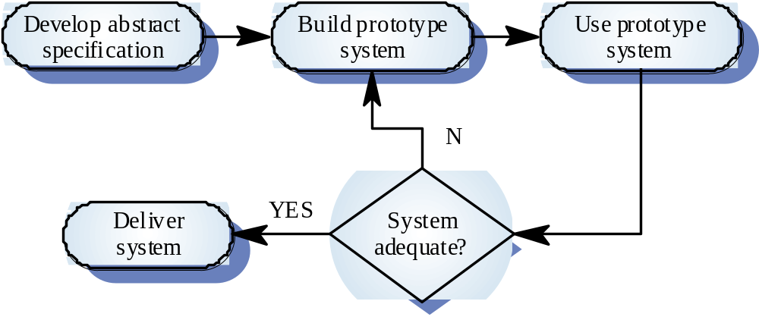
Evolutionary prototyping

Slide 28
Evolutionary prototyping advantages
Accelerated delivery of the system
  Rapid delivery and deployment are sometimes more important than functionality or long-term software maintainability
User engagement with the system
  Not only is the system more likely to meet user requirements, they are more likely to commit to the use of the system

Slide 29
Evolutionary prototyping problems
Management problems
  Existing management processes assume a waterfall model of development
  Specialist skills are required which may not be available in all development teams
Maintenance problems
  Continual change tends to corrupt system structure so long-term maintenance is expensive
Contractual problems
  Due to cost or time line agreed

Slide 30
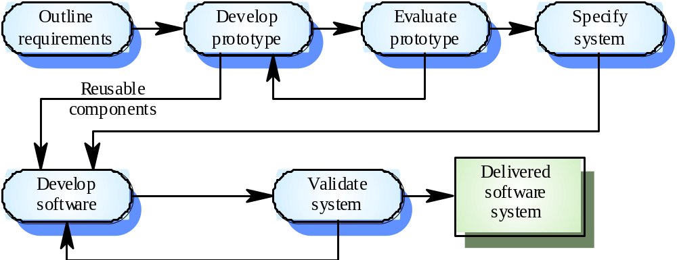
Throw-away prototyping

Slide 31
Throw-away prototyping
Used to reduce requirements risk
The prototype is developed from an initial specification, delivered for experiment then discarded
The throw-away prototype should NOT be considered as a final system
  Some system characteristics may have been left out
  There is no specification for long-term maintenance
  The system will be poorly structured and difficult to maintain

Slide 32
Prototyping Methods and Tools
A prototype must be developed rapidly so that the customer may assess results and recommend changes.
3 methods are available:
Fourth Generation Techniques (4GT)
  4GT enable the software engineer to generate executable code quickly, they are ideal for rapid prototyping.
  Ex. Tool for Database query language or reporting language.
Reusable software components
  To rapid prototyping is to assemble, rather than build, the prototype by using a set of existing software components.
  Should maintain library for existing software components
  An existing software product can be used as a prototype for a "new, improved" competitive product
Formal specification and prototyping environments
  Enable an analyst to interactively create language-based specifications of a system or software,
  Invoke automated tools that translate the language-based specifications into executable code,
  Enable the customer to use the prototype executable code to refine formal requirements.

Slide 33
Specification
Mode of specification has much to do with the quality of solution.
If specification incomplete, inconsistent, or misleading specifications have experienced the frustration and confusion that invariably results.
Specification Principles: May be viewed as representation process.
Separate functionality from implementation.
Develop a model of the desired behavior of a system.
Establish the context in which software operates by specifying the manner.
Define the environment in which the system operates and indicate how.

Slide 34
Specification Principles (cont.)
Create a cognitive model rather than a design or implementation model. The cognitive model describes a system as perceived by its user community.
The specifications must be tolerant of incompleteness and augmentable.
Establish the content and structure of a specification in a way that will enable it to be amenable to change.

Slide 35
Specification Representation
Representation format and content should be relevant to the problem.
  For example, a specification for a manufacturing automation system might use different symbology, diagrams and language than the specification for a programming language compiler.
Information contained within the specification should be nested (layered).
  Paragraph and diagram numbering schemes should indicate the level of detail that is being presented.
  It is sometimes worthwhile to present the same information at different levels of abstraction to aid in understanding.
Diagrams and other notational forms should be restricted in number and consistent in use.
  Confusing or inconsistent notation, whether graphical or symbolic, degrades understanding and fosters errors.
Representations should be revisable.

Slide 36
Software Requirements Specification
It contains a complete information description, a detailed functional description, a representation of system behavior, an indication of performance requirements and design constraints, appropriate validation criteria, and other information pertinent to requirements.
Format of SRS:
Introduction of the software requirements specification states the goals and objectives of the software, describing it in the context of the computer-based system.
Information content, flow, and structure are documented. Hardware, software, and human interfaces are described for external system elements and internal software functions.
Functional Description A processing narrative is provided for each function, design constraints are stated and justified & performance characteristics are stated
Behavioral Description operation of the software as a consequence of external events and internally generated control characteristics.

Slide 37
Software Requirements Specification (Cont.)
Validation Criteria is probably the most important and, ironically, the most often neglected section of the Software Requirements Specification (SRS). Testing or validating each user-scenario.
Finally, the specification includes a Bibliography and Appendix. The bibliography contains references to all documents that relate to the software. The appendix contains information that supplements the specifications

Slide 38
Specification Review
A review of the SRS (and/or prototype) is conducted by both the software developer and the customer.
Conducted at a macroscopic level
    Ensure that specification is complete
    Consistent
    Accurate (Information, functional and behavioral domain considered).
Review becomes more detailed while examining Information, functional and behavioral domain.
Examining not only broad descriptions but the way in which requirement worded.
E.g. Terms like “Vague ” (some, sometimes, often, usually) should be flag by reviewer for further clarification.

Slide 39
Review (cont.)
Once review is complete – SRS “signed off” by both customer and developer. ( “contract” for software development)
Requests for changes in requirements after the specification is finalized will not be eliminated.
Change is an extension of software scope and therefore can increase cost and/or delivery of product.
During the review, changes to the specification may be recommended.
It can be extremely difficult to assess the global impact of a change; that is, how a change in one function affects requirements for other functions

